Slide 1

Give FROM HAVE
PRESENTED BY:
P.Sravya
M.Sowmya
M.Mahalakshmi
M.Nagalakshmi
P.Rajyasree Nair

Slide 2
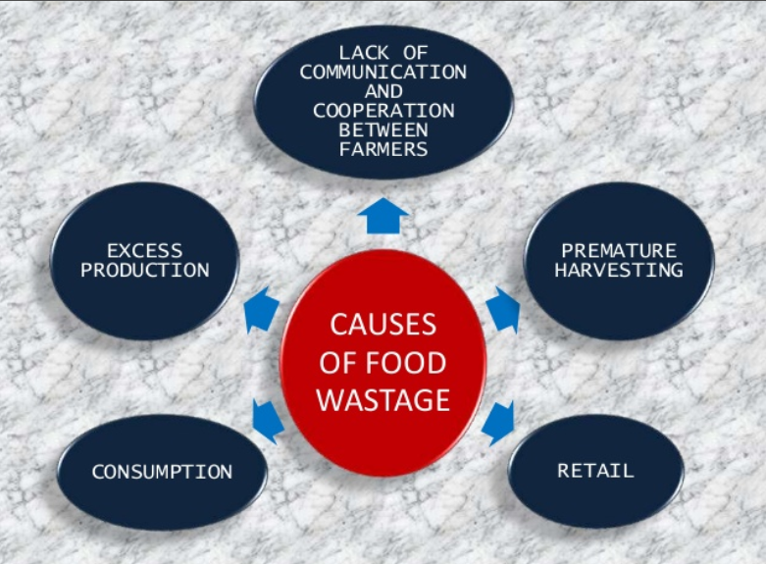
WHY?
Producing of food in excess amount especially during weddings or some other functions leads to wastage of food in most of the cases.
Poor food storage and infrastructure.
Due to the unpreferable variety of food items which leads to the unsatisfaction of the guests.

Slide 3
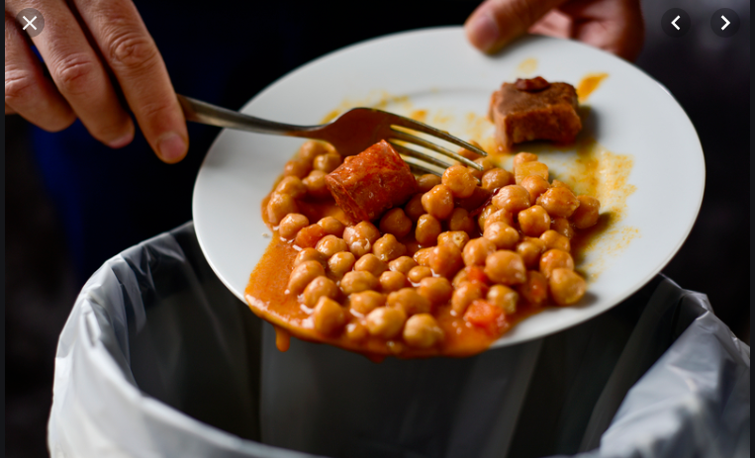
WHAT IS GFH?
Give From Have is completely about food donation from the food which is on the stream of wastage.
Even though world produces enough food to feed twice the world’s present population, food wastage is ironically behind the billions of people who are malnourished.

Slide 4
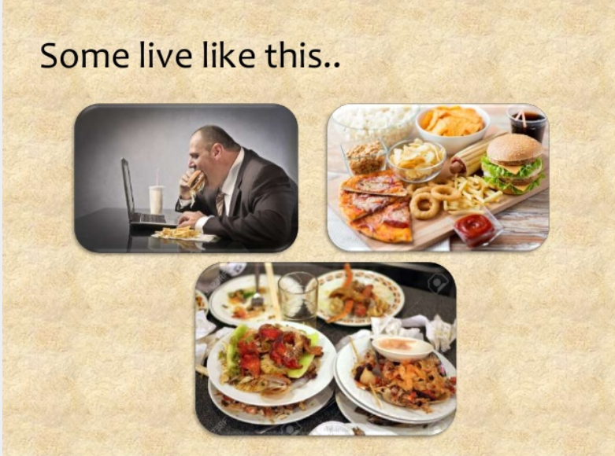
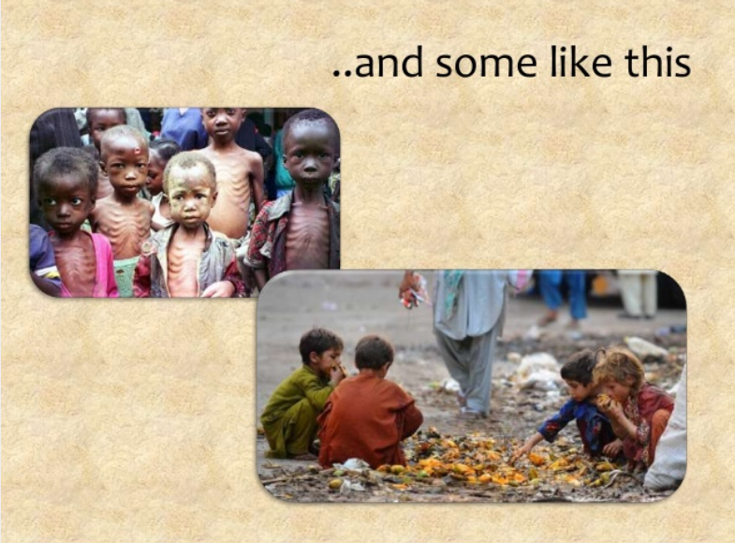
HOW
Creating a website through which we can be a medium for donating the food which was about to go into garbage.
Through this, the owners of the marriage hall or the event heads would intimate us regarding the food wastage which comes to us as notification.
We go to them through the specified location and collect the food and give it to the orphanages or to the one who is in very need of it.

Slide 5
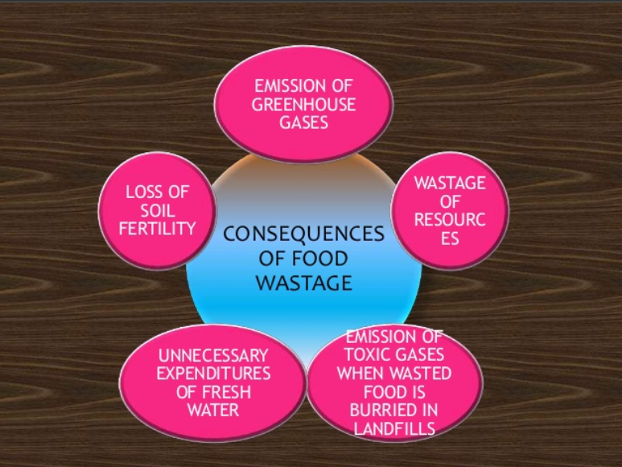

Slide 6
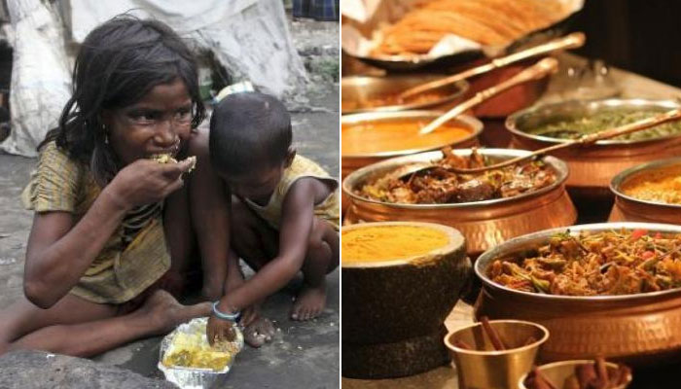
WE DONATE OUR LEFTOVER FOOD TO FEED THE HUNGRY

Slide 7
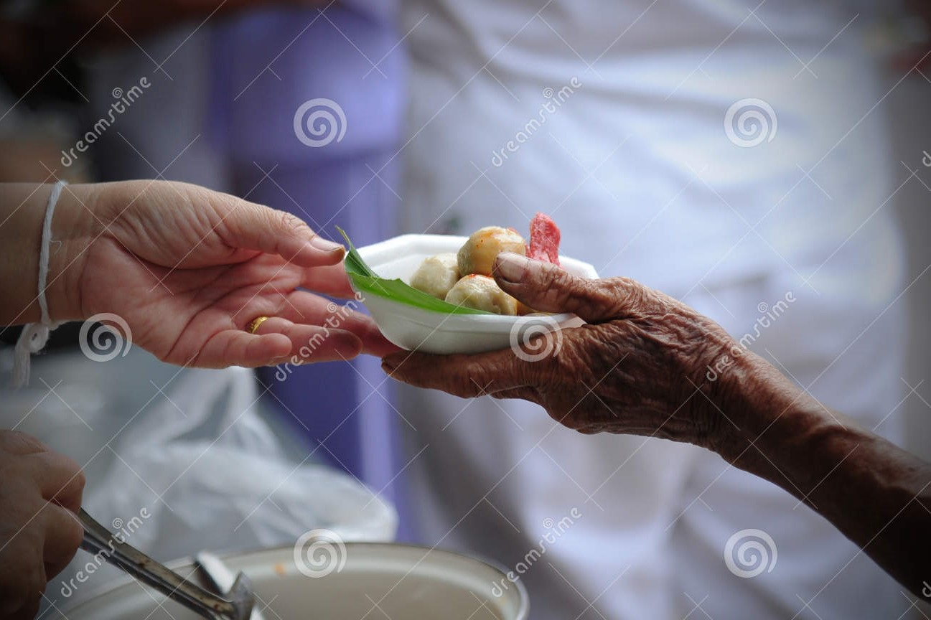
PEOPLE LIVE WHEN PEOPLE GIVE.

Slide 8


